Slide 1
Neural Architecture search
Anirudh Nallana(50560701) – anallana
Priyanka Garg(50560462) – pgarg2

Slide 2
What is neural architecture search ?

Slide 3
What is Neural architecture search?
To learn about Neural Architecture Search(NAS), we need to have a intuition about design of Neural Network Models and what goes into designing and building a top performing model for a particular dataset and usage agenda.
Neural Network models(say CNN models) are layered structures of neurons where neurons at same depth from the source node are said to be in the same layer. NN models implementation allow us to have many kinds of layers such as convolutional layers, dense layers, pooling layer etc., that together create an architecture where a basic multi-layered model can have upto a million parameters. It is humanely impossible to possess a skill to consider all the different kinds of layers and involved hyperparameters to eventually create a top-performing model on the first draft.
That is where Neural Architecture Search(NAS) comes into the picture!

Slide 4
What is Neural architecture search?
Neural Architecture Search (NAS) is a technique that helps in automatically creating neural network designs. It is basically a technique for automating the design of Neural Network models pertaining to the type of dataset that is going to be consumed. NAS aims to find the best network structure for tasks like image recognition or language processing by exploring various design options. By automating this process, NAS improves the performance of neural networks and reduces time and effort compared to manually designing and tuning these networks.

Slide 5
neural architecture search implementation

Slide 6
NAS implementation
Neural Architecture Search(NAS) implementation overall can be summarized under three modules :-
Search Space
Search Strategy
Performance Estimation Strategy

Slide 7
SEARCh space
A Search space consists of all the parameters being considered into the design of our optimal Neural Network model. The choices of parameters can be outlined as many things such as :- number of layers, whether a layer needs to be considered(Example:- additional convolutional hidden layer, a dense hidden layer etc.,), kernel size of respective convolutional layers, number of hidden units in dense layers, dropout choice and many more.
These choices help the NAS implementation to optimize the NN model design to find the best model suitable for our demands.

Slide 8
SEARCh strategy
A Search Strategy works inside the search space implementing a particular strategy to explore (all or some permutations of) the mentioned parameter choices. Different strategies offer various trade-offs between exploration efficiency and computational cost benefits.
It is important to discuss some prominent search strategies as these give us an intuitive idea about how the search in Neural Architecture Search performs.

Slide 9
RANDOM SEARCh strategy
Random Search is the simplest NAS strategy. It randomly samples architectures from the search space and evaluates them.
Pros:
Easy to implement
Baseline for comparing other strategies
Cons:
Inefficient in large search spaces
No guidance from previous evaluations

Slide 10
GRID SEARCh strategy
Grid Search Strategy systematically explores by evaluating all possible combinations of hyperparameters.
Pros:
Comprehensive exploration
Simple to understand
Cons:
Exponential growth of combinations with search space size
Computationally expensive

Slide 11
Bayesian optimization SEARCh strategy
This optimization search builds a probabilistic model of the objective function and used it to select the most promising architectures to evaluate next.
Pros:
Efficient in terms of number of evaluations
Can handle complex search spaces
Cons:
Computationally expensive to update the model
May get stuck in local optima
Reference :-arXiv:1802.07191v3 [cs.LG]

Slide 12
Reinforcement learning SEARCh strategy
This Search Strategy uses an RL-based controller which generates architectures and works to find the most optimum architecture with the help of reward signals.
Pros:
Can learn complex policies for architecture generation
Effective in large and discrete search spaces
Cons:
Requires significant computational resources
Training the controller can be unstable
Reference :- arXiv:1611.02167

Slide 13
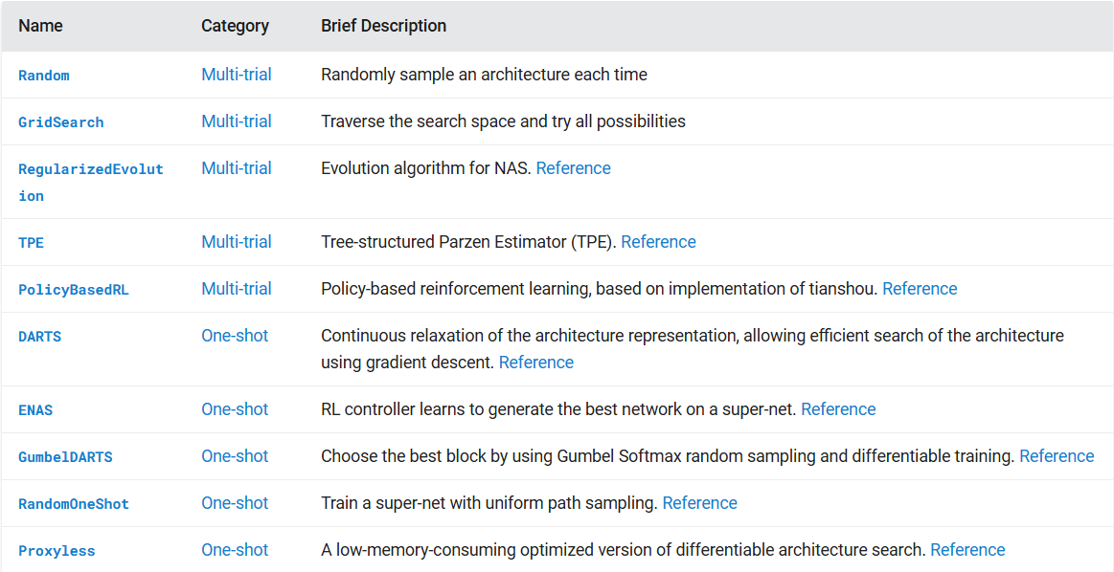
Reference :- Exploration Strategy — Neural Network Intelligence (nni.readthedocs.io)

Slide 14
Performance estimation strategy
In Neural Architecture Search (NAS), performance estimation strategies are crucial for evaluating the potential of candidate architectures. These strategies aim to provide a quick and reasonably accurate estimate of how well a given architecture might perform.
This strategy is thus important as it also guides the search process. The simplest way of performing estimation of an architecture’s performance is to train it on training data and evaluate its performance on validation data.

Slide 15
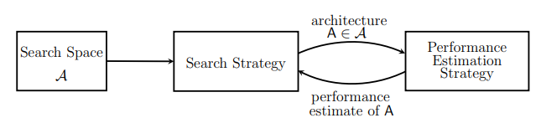
NAS IMPLEMENTATION
Source: arXiv:1808.05377

Slide 16
Nas IMPLEMENTATION PROCESS

Slide 17
1. Prepare dataset
This is the first step of every Data Science, ML project. In this process, we access the dataset, load it for execution, preprocess it, transform it and etc., eventually getting the dataset ready for execution.

Slide 18
2. Basic architecture model
This step allows us to decide what kind of neural network model we want to design using NAS :- CNNs, RNNs etc., After the decision, we may create a basic model which allows the NAS implementation to build upon.

Slide 19
3. Define search space
Search Space is vital to a Neural Architecture Search implementation. It lays a path which the NAS utilizes to design a opportune Neural Network Model.
In this step of the process, we define a search space considering all different parameters and their choices we wish to use to optimize our Neural Network Model design.

Slide 20
4. Define Model evaluator
The Model Evaluator is defined in this process. The model evaluator can be a simple strategy that evaluates validation performance of trained candidate models or can also involve advance strategies such as :- Learning Curve Extrapolation, Parameter Prediction etc.,

Slide 21
5. Decide on a search strategy
In this step, we decide on a search strategy we wish to choose to explore our search space. Some prominent search strategies :- Random Search, Grid Search, RL-controller etc.,

Slide 22
6. IMPlement NAS
We now have everything in order, for implementing Neural Architecture Search. In this step, we thus run the NAS experiment using our dataset, search space, search strategy and model evaluator

Slide 23
7. Compare candidate architectures
The implementation of NAS gives us an interesting view of Neural Network Model Design. We are now able to view all the candidate models that the NAS implementation explored and evaluated. We can compare these models and find the best performing model suitable to our needs.

Slide 24
CODE demo

